Slide 1
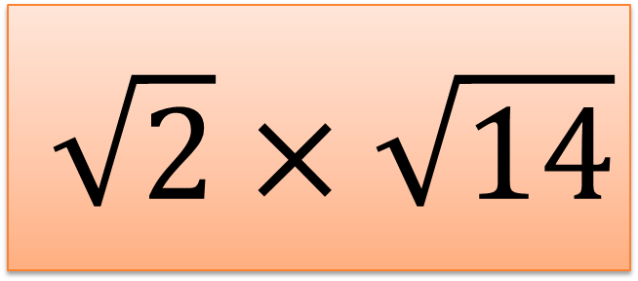

Surds Treasure Hunt
Surds Treasure Hunt
$$5\sqrt{6}$$
$$3+2\sqrt{2}$$
Previous Answer
Previous Answer
www.interactive-maths.com
www.interactive-maths.com
$$\frac{12}{\sqrt{6}}$$
$$\sqrt{2}×\sqrt{14}$$
Card 1
?
Card 2
?
To the next clue
To the next clue

Slide 2
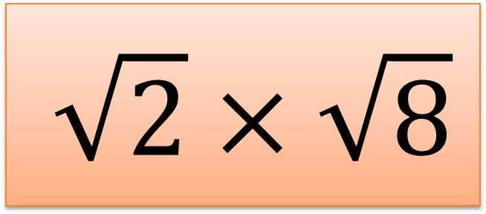

Surds Treasure Hunt
Surds Treasure Hunt
$$5\sqrt{3}$$
$$7$$
Previous Answer
Previous Answer
www.interactive-maths.com
www.interactive-maths.com
$$\frac{2\sqrt{3}}{\sqrt{6}}$$
$$\sqrt{2}×\sqrt{8}$$
Card 3
?
Card 4
?
To the next clue
To the next clue

Slide 3
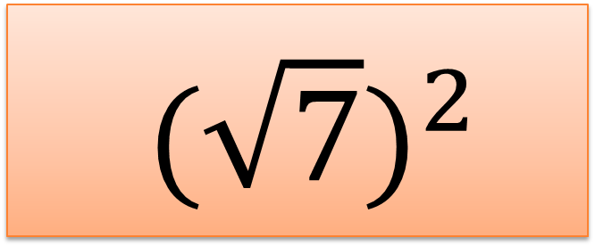
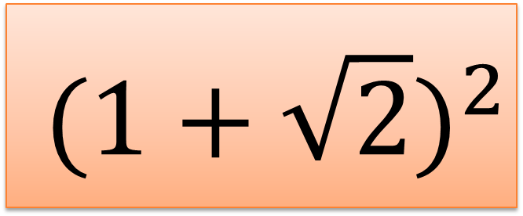
Surds Treasure Hunt
Surds Treasure Hunt
$$15\sqrt{2}$$
$$\sqrt{3}$$
Previous Answer
Previous Answer
www.interactive-maths.com
www.interactive-maths.com
$$(\sqrt{7})^{2}$$
$$(1+\sqrt{2})^{2}$$
Card 5
?
Card 6
?
To the next clue
To the next clue

Slide 4
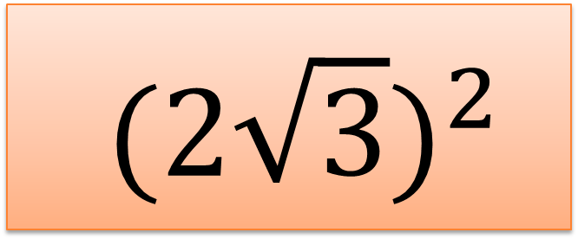
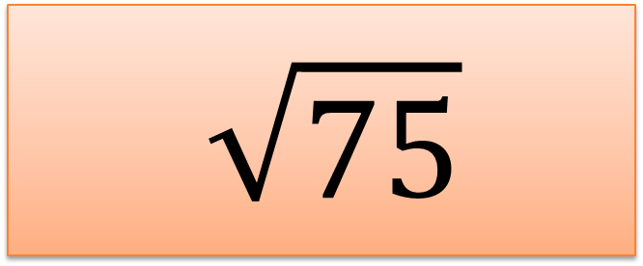
Surds Treasure Hunt
Surds Treasure Hunt
$$5\sqrt{5}$$
$$4−2\sqrt{3}$$
Previous Answer
Previous Answer
www.interactive-maths.com
www.interactive-maths.com
$$(2\sqrt{3})^{2}$$
$$\sqrt{75}$$
Card 7
?
Card 8
?
To the next clue
To the next clue

Slide 5
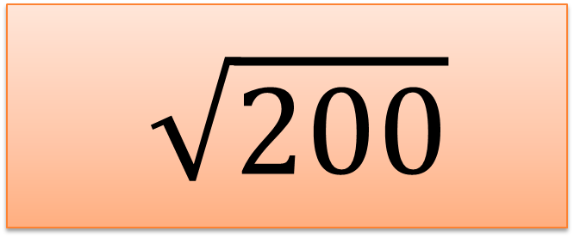
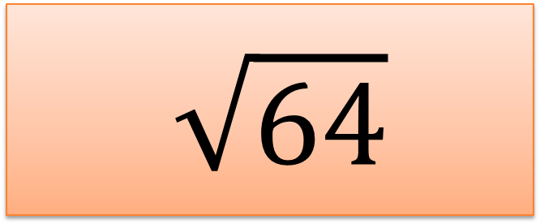
Surds Treasure Hunt
Surds Treasure Hunt
$$4\sqrt{5}$$
$$4\sqrt{2}$$
Previous Answer
Previous Answer
www.interactive-maths.com
www.interactive-maths.com
$$\sqrt{200}$$
$$\sqrt{64}$$
Card 9
?
Card 10
?
To the next clue
To the next clue

Slide 6
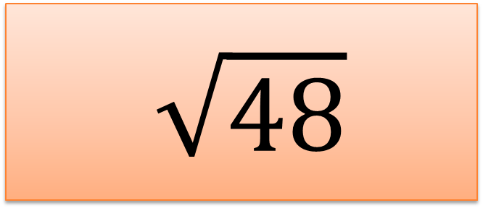
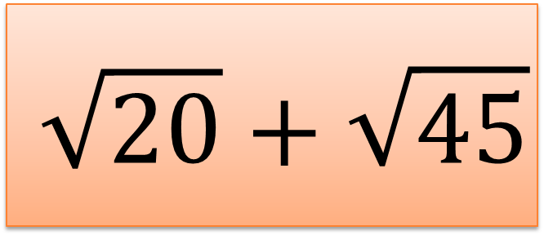
Surds Treasure Hunt
Surds Treasure Hunt
$$2\sqrt{7}$$
$$\sqrt{2}$$
Previous Answer
Previous Answer
www.interactive-maths.com
www.interactive-maths.com
$$\sqrt{48}$$
$$\sqrt{20}+\sqrt{45}$$
Card 11
?
Card 12
?
To the next clue
To the next clue

Slide 7
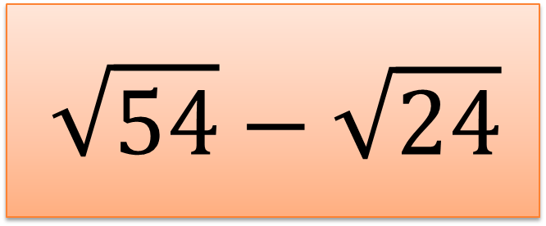

Surds Treasure Hunt
Surds Treasure Hunt
$$4$$
$$2\sqrt{6}$$
Previous Answer
Previous Answer
www.interactive-maths.com
www.interactive-maths.com
$$\sqrt{54}−\sqrt{24}$$
$$(1−\sqrt{3})^{2}$$
Card 13
?
Card 14
?
To the next clue
To the next clue

Slide 8
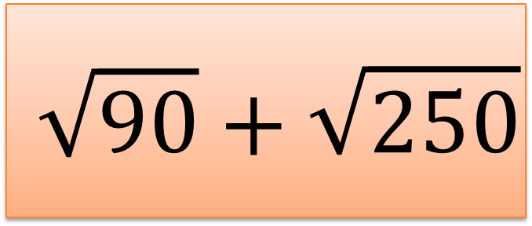
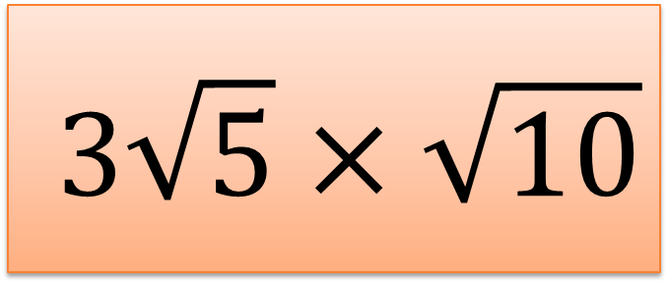
Surds Treasure Hunt
Surds Treasure Hunt
$$8$$
10$\sqrt{2}$
Previous Answer
Previous Answer
www.interactive-maths.com
www.interactive-maths.com
$$\sqrt{90}+\sqrt{250}$$
$$3\sqrt{5}×\sqrt{10}$$
Card 15
?
Card 16
?
To the next clue
To the next clue

Slide 9
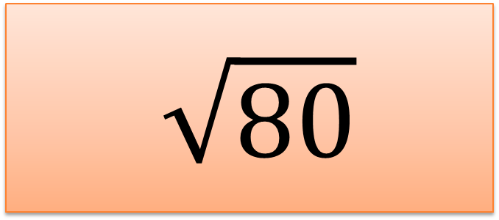
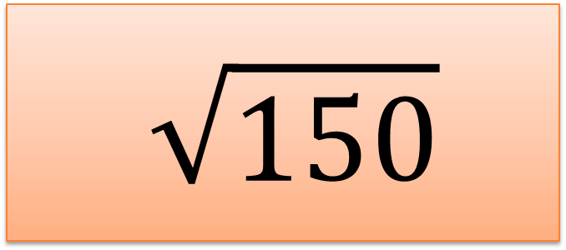
Surds Treasure Hunt
Surds Treasure Hunt
$$4\sqrt{3}$$
$$8\sqrt{10}$$
Previous Answer
Previous Answer
www.interactive-maths.com
www.interactive-maths.com
$$\sqrt{80}$$
$$\sqrt{150}$$
Card 17
?
Card 18
?
To the next clue
To the next clue

Slide 10
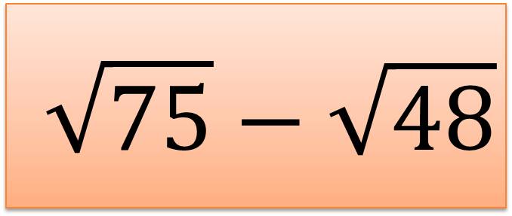
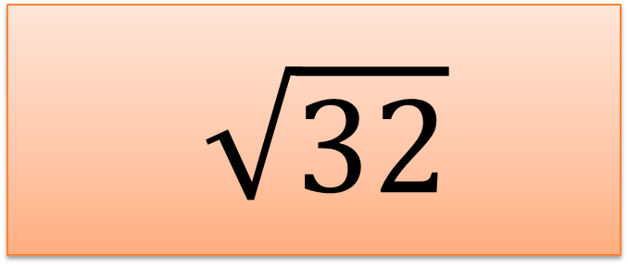
Surds Treasure Hunt
Surds Treasure Hunt
$$12$$
$$\sqrt{6}$$
Previous Answer
Previous Answer
www.interactive-maths.com
www.interactive-maths.com
$$\sqrt{75}−\sqrt{48}$$
$$\sqrt{32}$$
Card 19
?
Card 20
?
To the next clue
To the next clue

Slide 11
Surds Treasure Hunt

Slide 12
1
11
17
9
16
5
18
4
Surds Treasure Hunt
Answers
15
12
10
7
20
19
13
3
8
14
2
6

